Slide 1
College of Western Idaho SWDV 210 Introduction to Server Side Programming
Lab 9 – Chapter 8

Slide 2
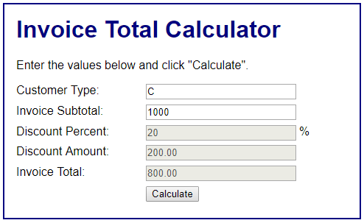
Lab 9 Chapter 8
Complete Exercises 8-1 on pages 259
All customer types should be converted to upper case
Post the link to your enhanced Invoice Total Calculator application in BB.
Expected output:

